Slide 1
Harry Potter generator
Author: Jon Lin, Chunyao Chen
Advisor: Dr. John D. Osborne

Slide 2
contents
Problem defined
Other models introduction
GPT2 introduction
Compare with other models
Section Title
Result
Demo
Difficulty

Slide 3
Problem defined
Sequence generator

Slide 4
True or False
Harry frowned at the edge of the pile of books.
"I don't know," he said slowly. "I mean, Dumbledore said there was no such thing as a Dark wizard. He was right."
"But what is a Dark wizard?"
"A wizard. No one ever does."
"A wizard goes off to do something they're sure will get them thrown out, like this," said Dumbledore. "It wasn't our idea what went wrong with Paracelsus, but we sure as hell hope he was trying to do it wrong. He's a wizard, after all."
"But he's not a Dark wizard?"
"Hardly. Some of us -- Hermione. A bit.
But a bit.
Harry was wondering what a wizard did once he'd finished school.
"Charlie's in Romania studying dragons, and Bill's in Africa doing something for Gringotts," said Ron. "Did you hear about Gringotts? It's been all over the Daily Prophet, but I don't suppose you get that with the Muggles -- someone tried to rob a high security vault."
Harry stared.
"Really? What happened to them?"
"Nothing, that's why it's such big news. They haven't been caught. My dad says it must've been a powerful Dark wizard to get round Gringotts, but they don't think they took anything, that's what's odd. 'Course, everyone gets scared when something like this happens in case You-Know-Who's behind it."

Slide 5
ERNIE V.S. BERT
BERT
ERNIE
Fine tuning framework
bidirectional approach
Extend task by add a single layer
continual pretraining framework
multi-task learning

Slide 6
Compare with BERT
 | GPT2 | BERT
Transformer | Decoder | Encoder
attention mechanism | Masked self attention mechanism | Self attention mechanism
Transformer blocks | 48 | 24
parameters | 1.5 billion | 340million

Slide 7
Compare with LSTM
The generated text is more fluence and the grammar is more natural
Good memory ability, can continue to generate articles related to the previous text without jumping around characters

Slide 8
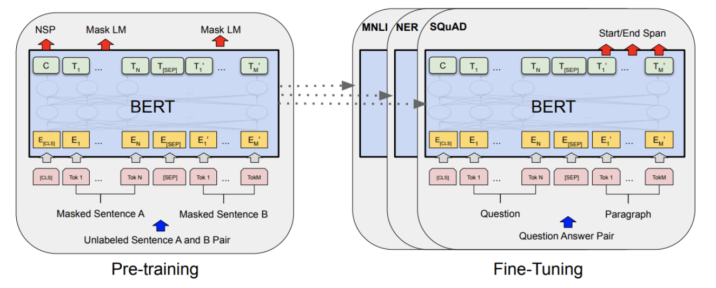
BERT
Formed with masked language modeling and next sentence prediction task

Slide 9
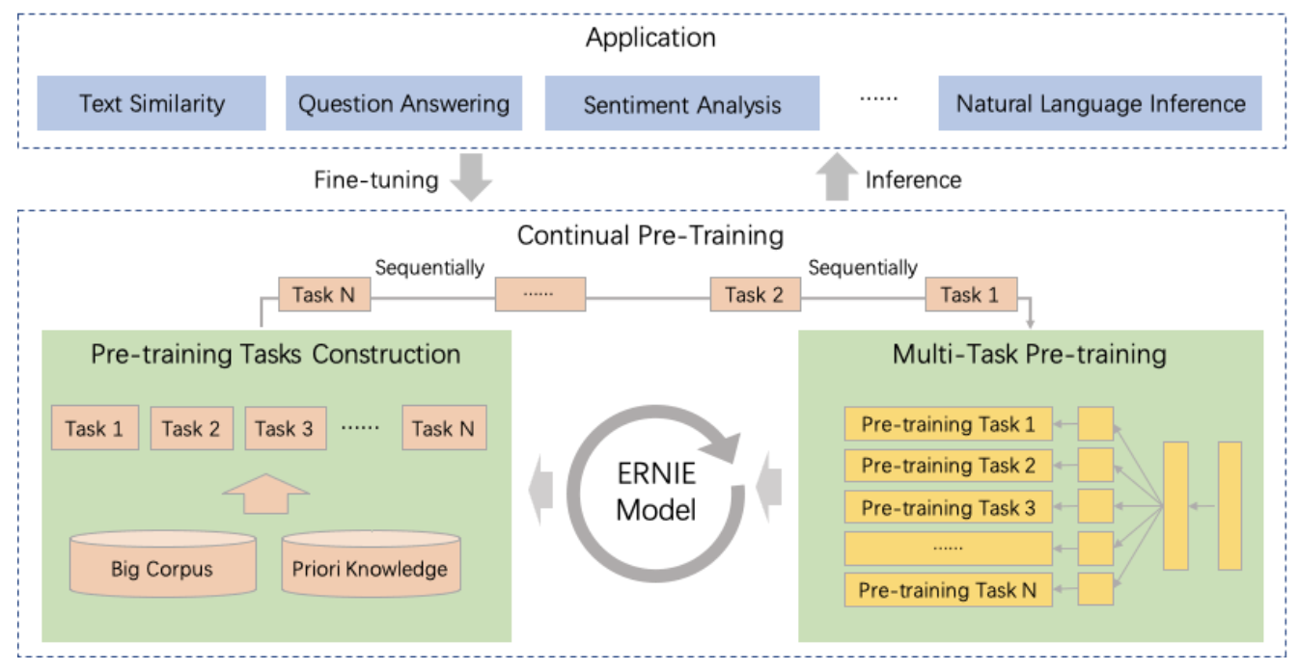
ERNIE
說明

Slide 10
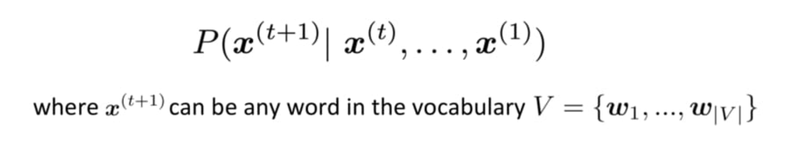
GPT2 - language model based on Transformer
Giving T words to predict T+1 word
A transformer decoder
The transformer decoder without Decoder-Encoder Attention Layer and other features.

Slide 11
Why GPT2?
Better performance
biggest training dataset
Largest parameter
Fully society group support.
we are applying GPT3 API from open AI, but approval take time

Slide 12
How does GPT2 works?
Unsupervised learning (insert text without annotate)
Finetune (adjust the model)

Slide 13
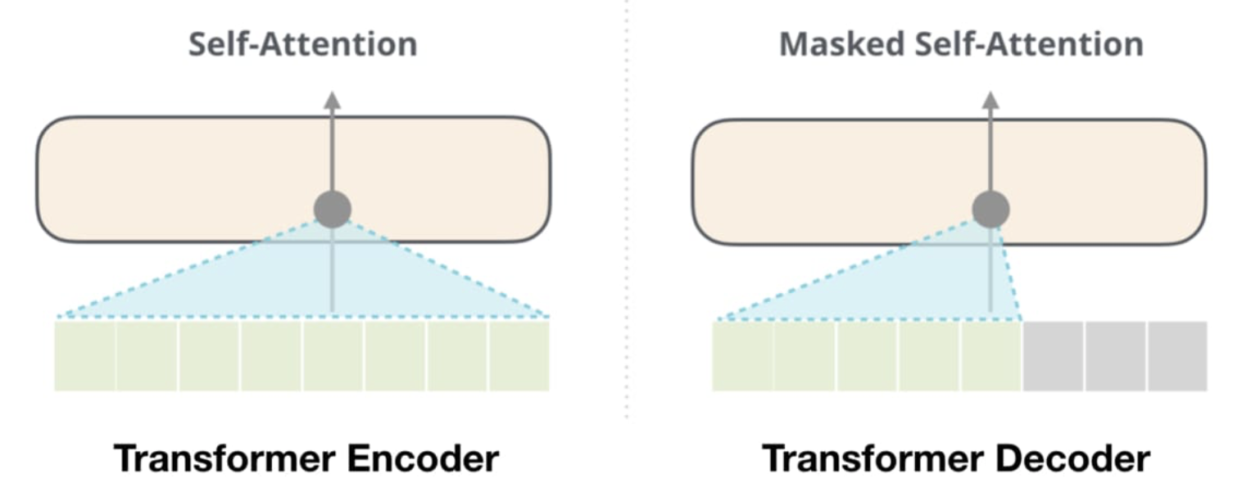
Self attention mechanism

Slide 14
RESULT

Slide 15
Requirement
Colab (Google Colaboratory)
TensorFlow 1.x
GPT2

Slide 16
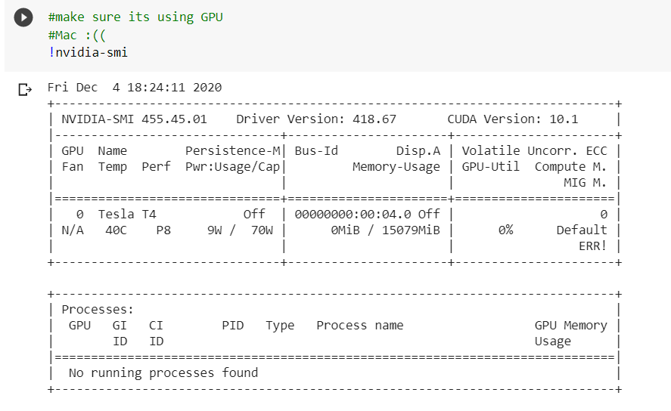

Slide 17
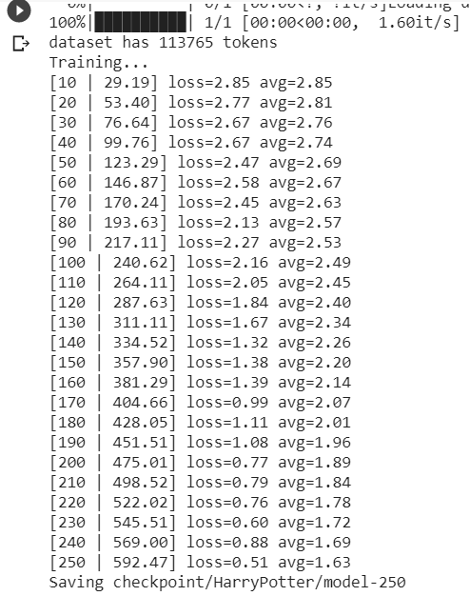
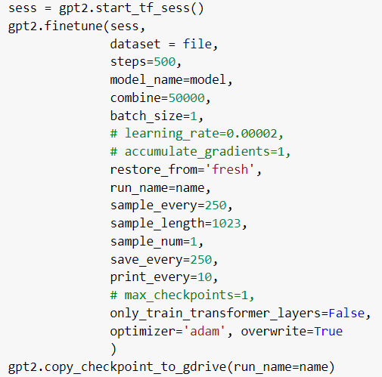
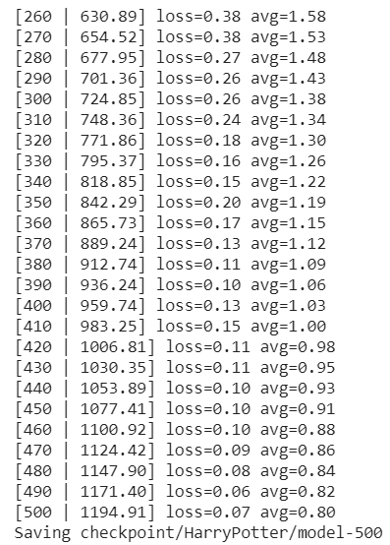

Slide 18
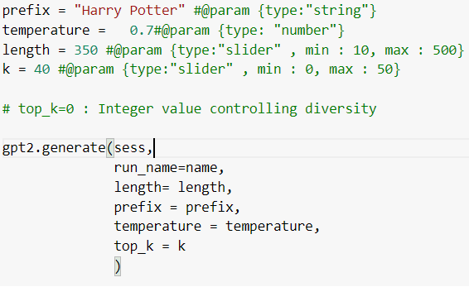

Slide 19
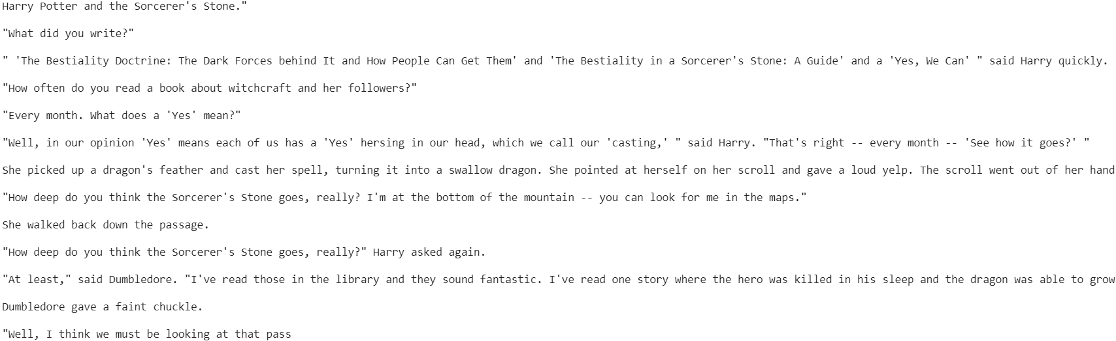

Slide 20
DEMO

Slide 21
Difficulty

Slide 22
All models are wrong, but some are useful
George E. P. Box

Slide 23
Thank you!

